Slide 1

META - FACEBOOK DISTRIBUTED SYSTEM
Facebook - Building Global Connectivity.

Slide 2
Introduction
Founded in 2004, Facebook aims to empower global connectivity, facilitating friendships and openness. Users can share various content types, fostering engagement through comments and likes. The system, inspired by technologies like Hadoop and Hive, utilizes high-tech servers and geographically distributed data centers. Integration of cloud computing ensures scalability and stability, supporting dynamic growth while maintaining performance metrics.

Slide 3

Facebook - Features
Core Features:
Wall: Original profile space where users post text, multimedia, photos, and videos, visible to chosen audiences.
News Feed: Displays real-time updates of friends' activities, profile changes, and upcoming events.
Timeline: Organizes user content chronologically, including posts, photos, and videos.
Friendship: Central feature allowing users to connect with others, manage friend lists, and send/receive friend requests.
User Accessibility:
Users can easily access Facebook via any internet-enabled device, including desktops and mobile devices.
Registration is a simple process, requiring a username and password, followed by friend invitations and profile setup.
Messaging Services:
Messaging and Outbox: Allows users to send messages, including text, instant messages, emails, and regular messages, to individuals or groups.

Slide 4
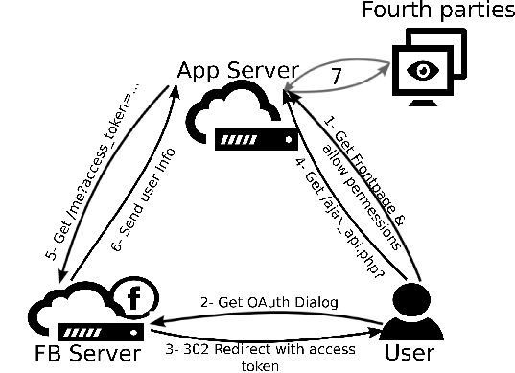
Facebook - Architecture
Facebook, the online social network (OSN) system, relies on globally distributed data centers, with scalability, availability, openness, reliability, and security as major requirements. It employs a 3-tier architecture to handle data flow originating from client requests.
Fig: Overview of the Facebook application architecture

Slide 5
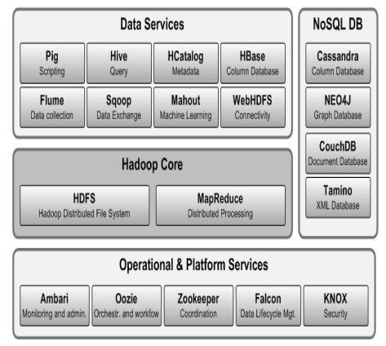
Fig: System architecture

Slide 6
System Components
Data Sources: Represent various sources from where data enters the Hadoop ecosystem, including web logs, social media feeds, sensor data, and traditional databases.
Data Ingestion Tools (Flume, Sqoop): Facilitate smooth data movement from these sources into HDFS. Flume is adept at handling real-time streaming data, while Sqoop efficiently transfers data from relational databases to HDFS.
HDFS (Hadoop Distributed File System): The heart of data storage, HDFS breaks down large datasets into smaller blocks and distributes them across multiple machines in the cluster. This distributed storage ensures scalability and fault tolerance – if one machine fails, the data remains accessible on other nodes.
Data Management Tools (Avro, Parquet): These tools define data formats optimized for efficient storage and retrieval within HDFS. Avro and Parquet offer schema-based data structures that enhance data compression and querying compared to plain text files.

Slide 7
YARN (Yet Another Resource Negotiator): Acts as the central traffic controller, allocating resources like CPU, memory, and network bandwidth across the cluster to running applications. This enables efficient resource utilization and supports running multiple frameworks within the Hadoop ecosystem.
MapReduce: The original paradigm for parallel processing of big data. MapReduce breaks down large datasets into smaller tasks (map and reduce phases) that can be distributed across the cluster for efficient computation. While powerful, MapReduce can be less suitable for iterative or real-time processing needs.
Spark: A more recent framework gaining traction for big data processing. Spark offers in-memory processing capabilities, allowing for faster iterative tasks compared to MapReduce's disk-based approach. Additionally, Spark supports a wider range of functionalities beyond just MapReduce-style processing.
Hive and Pig : As discussed earlier, Hive and Pig provide layers of abstraction over MapReduce. Hive leverages SQL-like syntax (HiveQL) for querying data stored in HDFS, making data analysis accessible to users with SQL expertise. Pig, on the other hand, uses Pig Latin, a high-level language, for scripting complex data transformations.

Slide 8
Hadoop Ecosystem Tools (HBase, Phoenix): These tools offer options for storing and querying data in real-time or low-latency scenarios. HBase is a NoSQL database built on top of HDFS, while Phoenix provides a low-latency layer for querying HBase data using SQL-like statements.
BI (Business Intelligence) Tools: Data processed and analyzed within the Hadoop ecosystem can be visualized and presented using various BI tools. These tools allow users to explore trends, identify patterns, and gain insights from their big data. Examples include Tableau, Power BI, and QlikView.
Zookeeper: Ensures coordination and consistency among different services in the Hadoop ecosystem. It plays a crucial role in maintaining a healthy and synchronized cluster by providing services like leader election and distributed locking.
Oozie: A workflow scheduler for managing and automating data processing jobs within the Hadoop ecosystem. Oozie helps orchestrate complex workflows involving multiple steps and dependencies between different tools.
Security (Knox, Sentry): Security tools like Knox and Sentry are crucial for securing the Hadoop ecosystem by managing user access, authentication, and authorization for data stored and processed within the cluster.

Slide 9
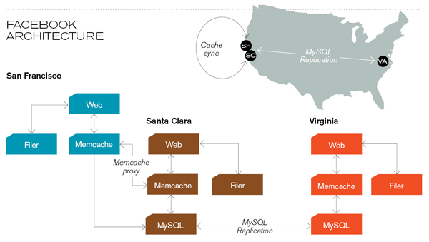
How Facebook Works (Example)?

Slide 10
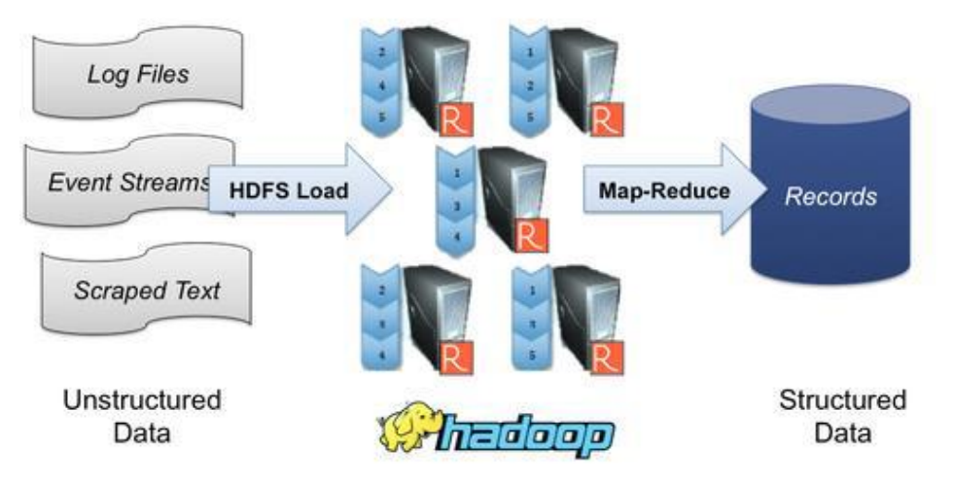
Distributed Framework - HADOOP
Hadoop, a distributed computing framework, comprises three primary components:
MapReduce: Application layer (Responsible for computation tasks across the cluster).
Hadoop Distributed File System (HDFS): Handles storage, storing and managing data across the cluster.
Yarn: Resource management layer.

Slide 11
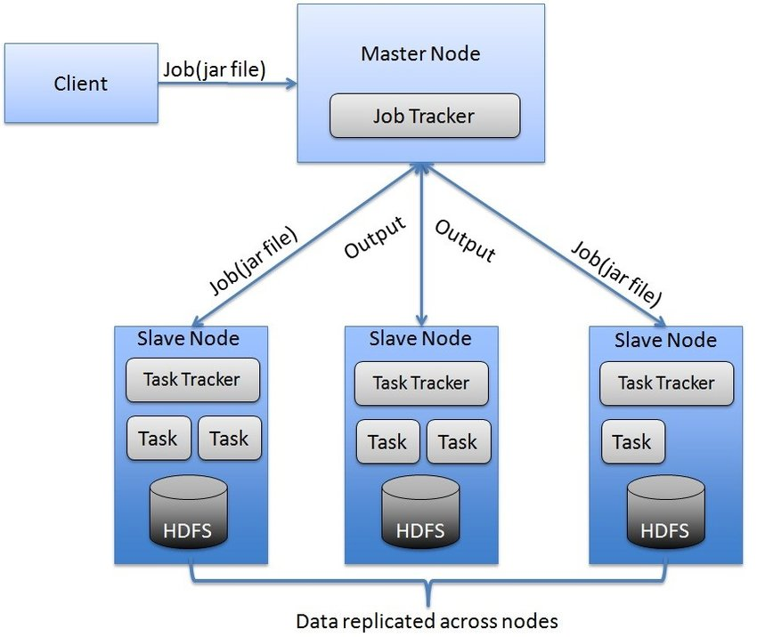
Master Slave Hadoop Architecture

Slide 12
Hadoop - Map Reduce
Facebook's data centers handle terabytes and petabytes of data daily, necessitating efficient processing and analysis methods like Map Reduce.
1. Mapper-Reducer Workflow:
- Utilizes key/value pairs to index data from HDFS.
- Data is divided into blocks and replicated for system resilience.
2. Job Execution:
- Submit M-R job and details to Job Tracker.
- Job Tracker contacts Task Tracker on each Data Node (DN) to schedule tasks.

Slide 13
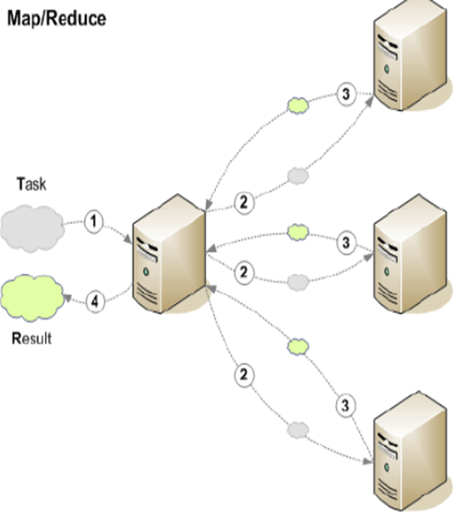
3. Map Phase:
- Mapper processes data blocks, generating key-value pairs.
- Sorts key-value pairs and transfers mapped results to reducers in sorted format.
4. Reduce Phase:
- M-R merges sorted key-value pairs to generate final results.
- Results are stored in HDFS and replicated for accessibility.

Slide 14
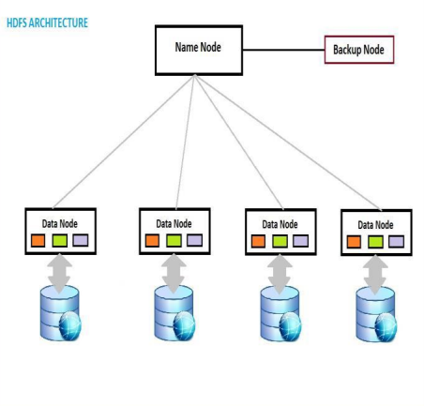
Hadoop distributed file system (HDFS)
Scalable and Fault-Tolerant Data Storage
Facebook relies on the Hadoop Distributed File System (HDFS) to manage its vast amounts of data efficiently.
Key Features of HDFS:
Designed for Low-Cost Hardware
Supports Large Data Sets
Scalable Architecture

Slide 15
HDFS Characteristics:
Batch Processing Emphasis: Prioritizing high throughput of data access over low latency.
Write-Once-Read-Many (WORM) Model: Files in HDFS follow a write-once-read-many access model, simplifying data consistency issues and enabling high throughput data access.
Internal Structure:
File Storage:Files are split into blocks and stored in Data Nodes within the HDFS cluster.
Name Node: Acts as the arbitrator and repository for all HDFS metadata, simplifying the system's architecture.
Data Flow:User data never flows through the Name Node, ensuring efficient data handling.

Slide 16
Hadoop - Hive
In Facebook, Hive serves as a data warehouse infrastructure built on top of Hadoop technology, providing tools for easy data summarization, reporting, ad hoc querying, and analysis of large datasets stored in Hadoop Distributed File System (HDFS).
Key Functions of Hive:
Data Summarization: Enables summarization of large datasets for reporting and analysis purposes.
Ad Hoc Querying: Facilitates ad hoc querying of data using a simple query language called HiveQL, based on SQL.
Ease of Use: Allows users familiar with SQL to easily query and analyze data without the need for writing complex MapReduce programs.

Slide 17
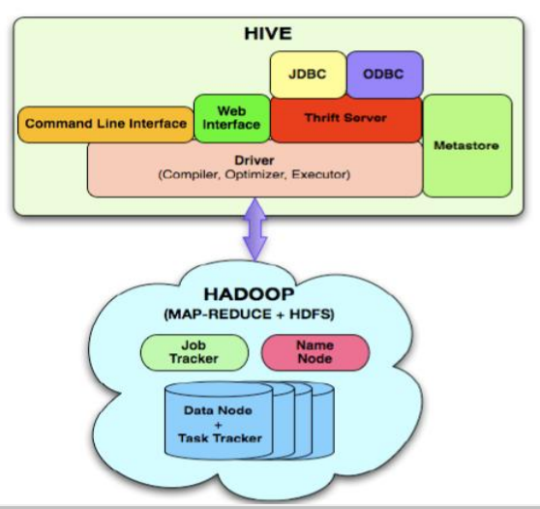
Advantages of Using Hive:
Increased Efficiency:Tasks that would take hours or days without Hive can be completed in minutes with Hive's simplified approach.
Scalability for Non-Engineering Users:Hive brings the scalability of MapReduce to non-engineering users, such as business analysts and product managers, enabling them to leverage data analysis capabilities without programming expertise.

Slide 18
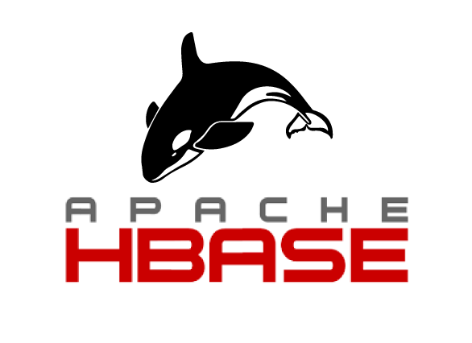
Hadoop ApacheHBase
Key Features:
Scalability: Handles billions of messages.
Real-Time: Supports low-latency messaging.
Tradeoffs: Configured for advantages.
Advantages:
Increased Capacity: Manages large volumes.
High Throughput: Efficient write operations.
High Availability: Ensures uptime.
Zero Downtime: Continues operation during failures.

Slide 19

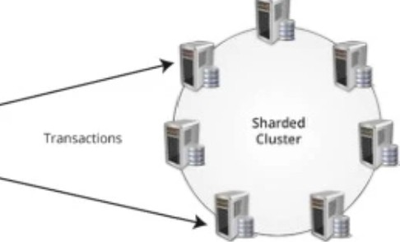


Apache Cassandra
Apache Cassandra is a free and open-source distributed NoSQL database management system designed to handle large amounts of data across many commodity servers, providing high availability with no single point of failure.
Multi-server Sharded System
Clients
APACHE CASSAN DRA CERTI FICATION TRAINING

Slide 20
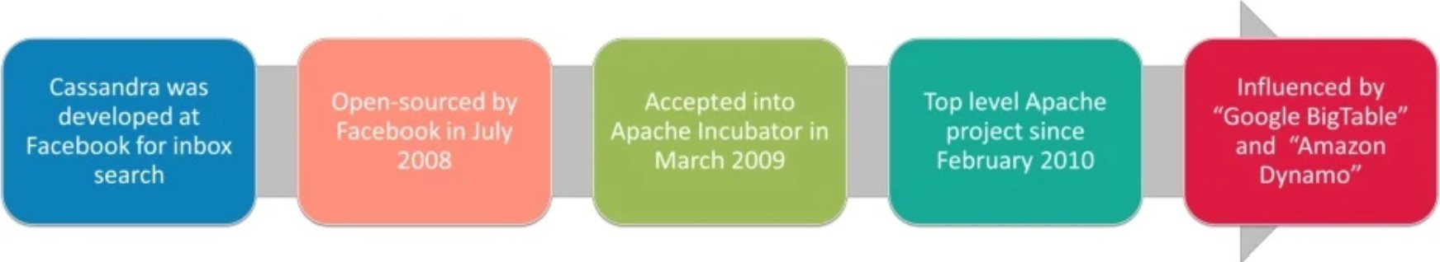
History of Cassandra

Slide 21
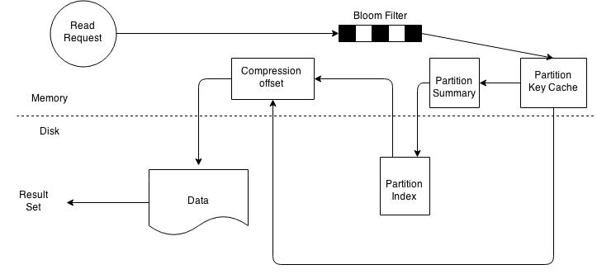
Cassandra Architecture

Slide 22
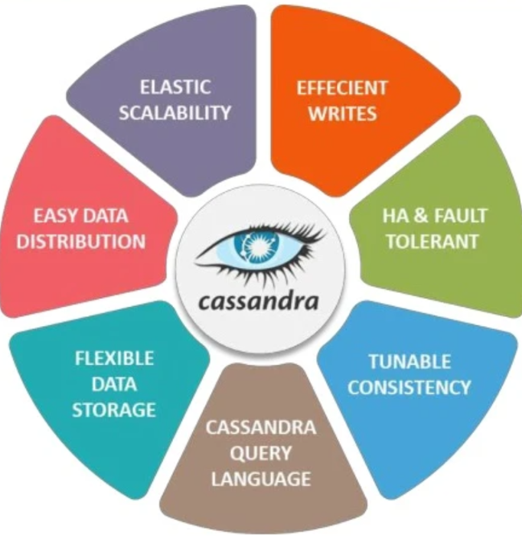
Features of Cassandra

Slide 23
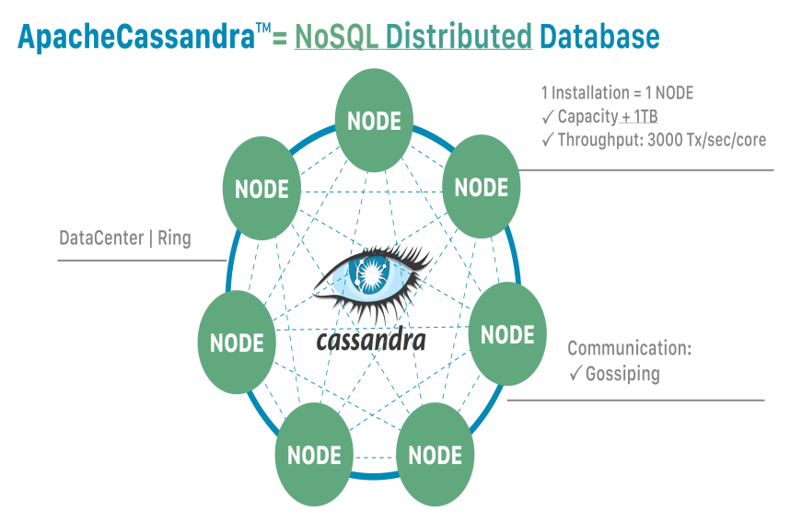
Distribution provides power and resilience
Distributed Architecture: Cassandra databases are distributed across multiple machines, providing scalability and fault tolerance.
Fault Tolerance: Distribution prevents data loss from hardware failures, ensuring data resilience.
Peer-to-Peer Communication: Nodes communicate using the gossip protocol, facilitating coordination.
Masterless Architecture: Each node provides the same functionality, enhancing resilience.
Cluster Organization: Nodes are organized into a cluster or "ring" for efficient management and scalability.

Slide 24
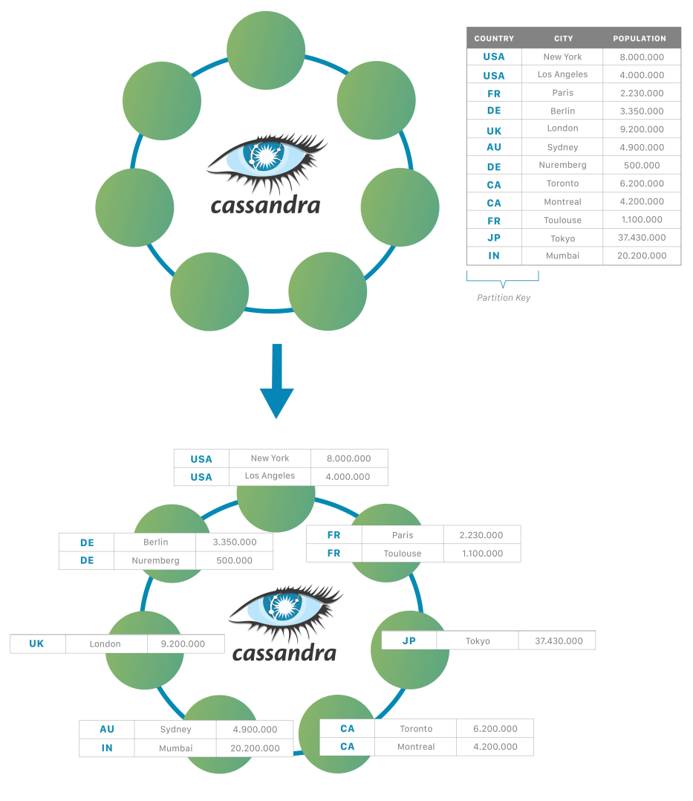
Want more power? Add more nodes
Dynamic Scalability: Cassandra allows developers to scale databases dynamically using off-the-shelf hardware, without downtime.
Horizontal Scalability: Unlike traditional databases like Oracle or MySQL, Cassandra scales horizontally (scale-out) by adding more nodes rather than increasing CPU power, RAM, or disk speed.
Cost-Effective Scaling: Scaling Cassandra involves adding lower-cost commodity hardware, making it more cost-effective compared to traditional scaling methods.
Simple Expansion: To increase data capacity or throughput, simply double the number of nodes, without complex hardware upgrades.
Flexible Scaling: Cassandra offers the flexibility to scale up or down based on application requirements, with no downtime.
Linear Scalability: The scalability of Cassandra is linear, meaning doubling the number of nodes doubles the capacity or throughput, with this capability extending indefinitely.
Key Strength: Cassandra's ability to scale linearly without constraints has become one of its defining strengths.

Slide 25
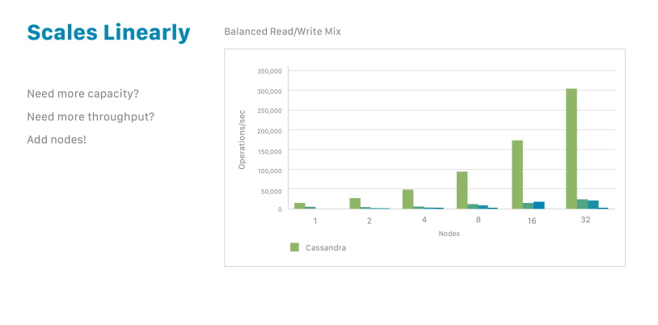
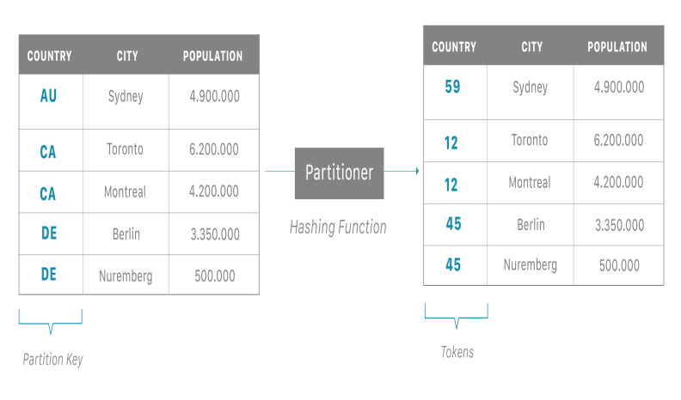
Introducing partitions
Automatic Data Distribution: Cassandra employs partitions to automatically distribute data across the cluster. Each node is assigned specific tokens, and data is distributed based on these token ranges, facilitating linear scalability.
Partition Key and Data Distribution: The partition key plays a vital role in distributing data among nodes and determining data locality. A hash function applied to the partition key determines the node that will store the data based on the token range.
Replication for Reliability: Cassandra ensures reliability and fault tolerance through data replication. The coordinator node assigns data to a partition and forwards it to the appropriate replica node responsible for that token range.
Replica Nodes: Data can be replicated to multiple replica nodes, enhancing redundancy and fault tolerance. The replication factor (RF) determines the number of replicas for each piece of data.
Coordinator Node Flexibility: The coordinator node, which can be any node in the cluster, is not fixed to a single location. This flexibility improves system robustness, as any node can act as the coordinator depending on the request received.

Slide 26
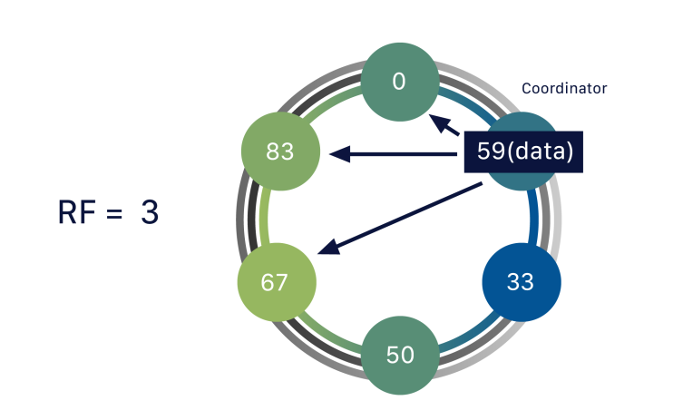
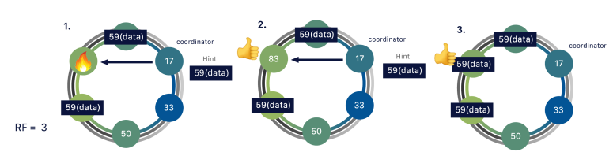
Replication ensures reliability and fault tolerance
Replication Factor (RF): Determines the number of data copies stored in Cassandra, ensuring fault tolerance
.Resilience and Fault Tolerance: Cassandra's distributed nature enables self-healing and data availability even during failures.
Self-Healing Mechanism: Coordinator nodes store hints and automatically repair replicas, ensuring consistency.
Performance Benefits: Multiple replicas distribute workload, enhancing system performance
.Cross-Data Center Replication: Data is automatically replicated across data centers, minimizing latency for global access.

Slide 27
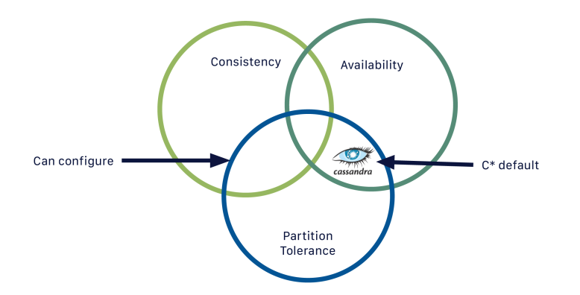
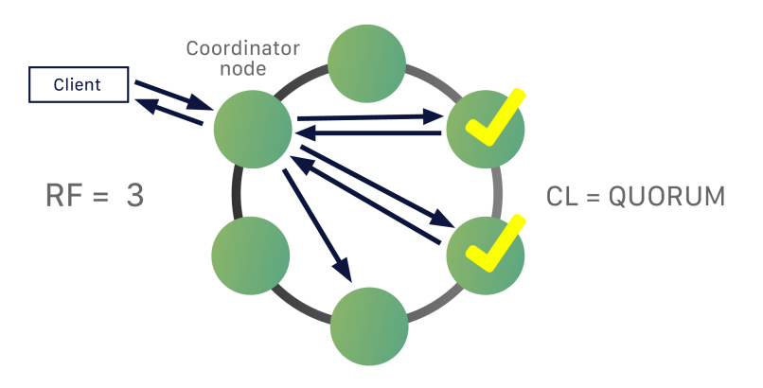
Tuning consistency
CAP Theorem and Cassandra: Cassandra is inherently an AP (Available Partition-tolerant) database, meaning it prioritizes availability and partition tolerance over strict consistency.
Consistency Level (CL): Represents the minimum number of nodes that must acknowledge a read or write operation for it to be successful.
Configurability: Cassandra allows configuring consistency levels on a per-query basis, providing flexibility in balancing performance, availability, and data integrity.
Example: With a replication factor of three and a consistency level of QUORUM (requiring acknowledgment from 2 out of 3 replicas), the coordinator needs acknowledgment from two replicas for a successful query.
Granular Control: While tuning consistency levels requires skill, Cassandra's granularity in control allows for detailed deployment management.

Slide 28
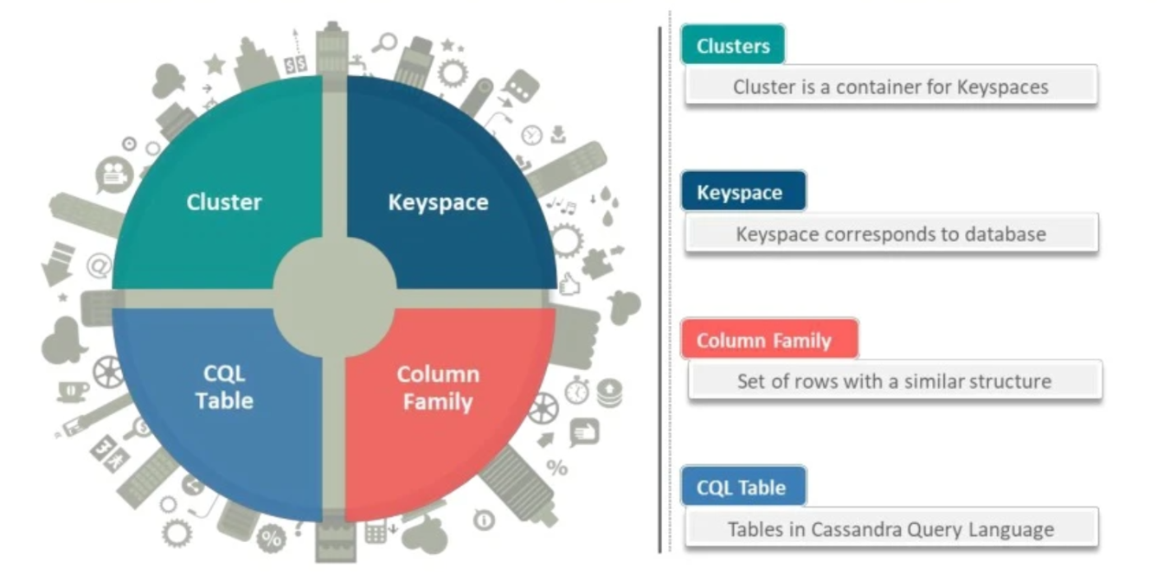
Cassandra Database Elements

Slide 29
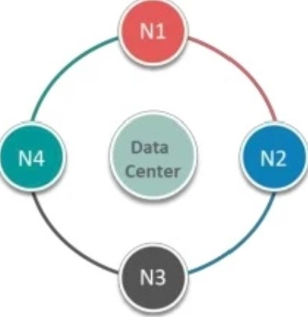
Clusters
The outermost structure in Cassandra is the cluster.
Cluster is a container for Keyspaces
Sometimes called the ring, because Cassandra assigns data to nodes in the cluster by arranging them in a ring.
A node holds a replica for different range of data
Each node in the cluster is responsible for storing and processing data.
Facilitates horizontal scalability and fault tolerance.

Slide 30
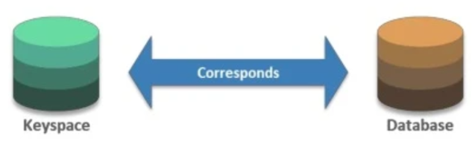
Keyspaces
Serve as logical containers for data.
Similar to databases in traditional relational databases.
Organize related tables and column families.
Define replication strategies and data distribution policies.
Allow for isolation and management of data access and permissions.
Eg:
Connected to Test Cluster at 127.0.0.1:9042.
cqlsh> CREATE KEYSPACE ABC WITH replication = {'class': 'SimpleStrategy', 'replication_factor': '3'
AND durable writes = TRUE;}

Slide 31
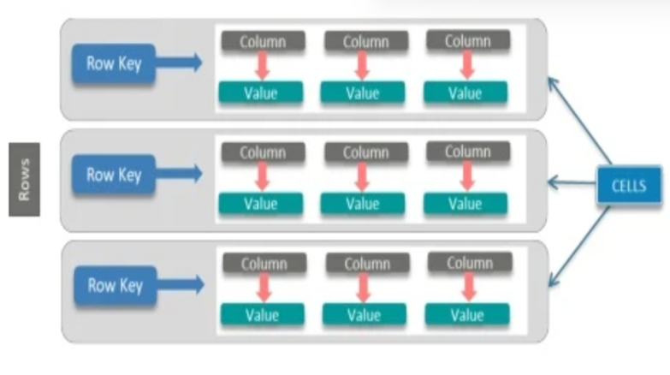
Column Family And CQL Table
A column family is a container for an ordered collection of rows, each of which is itself an ordered collection of columns
We can freely add any column to any column family at any time,depending on your needs.
CQL tables provide two-dimensional view of a column family which contains potentially multi·dimensional data.
CQL table and column family are largely interchangeable terms
Eg:
[cqlsh:abc> CREATE TABLE race_winners ( race_position int, cyclist_name text,PRIMARY KEY (race_name, race_position));
cqlsh:abc>

Slide 32
Facebook's Content Distribution Network
Facebook's Content Distribution Network (FBCDN) delivers photos and videos to Facebook users. The FBCDN stack has multiple backend storage systems and multiple layers of caches. The FBCDN team has studied the stack to find ways to improve it. Some of their findings include:
Advanced caching algorithms: Some advanced caching algorithms, like Quadruply Segmented LRU (S4LRU), can increase the hit ratio of caches.
BlockCache: This solution applies Segmented LRU logic to large fixed-size blocks of items.
Larger caches: Larger caches improve hit ratios.
Being smarter about what items you keep in the cache: Can also improve hit ratios.

Slide 33
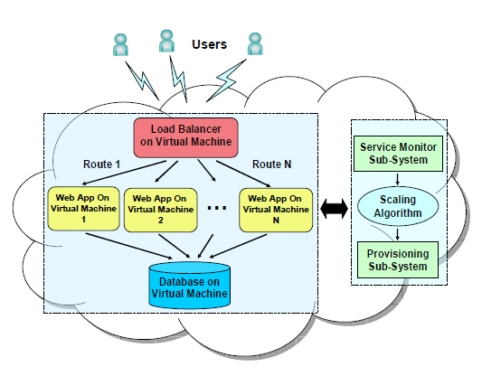
Cloud Computing’s Role

Slide 34
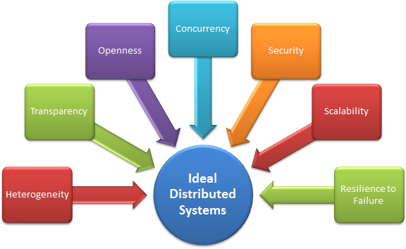
Distributed System Characteristics –FB Edition
1. Resource Sharing: Facebook allows users to share various resources such as photos, videos, and documents across the platform, demonstrating the ability to utilize data anywhere in the system.
2. Openness: Facebook regularly updates and improves its system, often incorporating user feedback and suggestions, showcasing openness in software development and sharing.
3.Concurrency: Facebook's distributed architecture allows multiple users from remote locations to concurrently access and perform activities on the platform, demonstrating concurrency in action.

Slide 35
4. Scalability: Facebook accommodates millions of users and data interactions daily, showcasing its ability to scale to meet growing demands while maintaining responsiveness.
5. Fault Tolerance: Facebook's system architecture is designed to handle hardware or software failures without degrading performance, ensuring uninterrupted service for users.
6. Transparency: Fabebook hides the complexities of its distributed system from users and application programs, providing a seamless experience while maintaining privacy and security.
7. Heterogeneity: Facebook's system components, including networks, hardware, operating systems, programming languages, and developer implementations, can vary, showcasing heterogeneity in distributed systems.

Slide 36
Conclusion
In conclusion, Facebook's distributed system architecture, built on highly equipped data centers and leveraging technologies like Hadoop, ensures availability and reliability. Geographically distributed data centers and CDN replication support scalability. Enhancements such as real-time messaging and integration with cloud computing further optimize performance and scalability. Overall, Facebook's distributed system continues to evolve to meet the demands of its rapidly growing user base while maintaining reliability and performance.

Slide 37
References
Salem, Asma. (2017). Facebook Distributed System Case Study For Distributed System Inside Facebook Datacenters. 10.13140/RG.2.2.15877.04329.
Contents from ”Engineering at meta”.
https://cassandra.apache.org/doc
https://hadoop.apache.org/docs

